Slide 1
Hiring Process Analytics
Name – Samiksha Zagade

Slide 2
PROJECT DESCRIPTION
The objective of this project is to analyze the company's hiring process data and draw meaningful insights from it. The hiring process is a crucial function of any company, and understanding trends such as the number of rejections, interviews, job types, and vacancies can provide valuable insights for the hiring department. I have been given a dataset containing records of previous hires. After analysing the data I have answered certain questions that can help the company improve its hiring process. I have used Microsoft Excel 2019 to do this project.

Slide 3
Data
I started by first cleaning the data-
Handling Missing Data
Outlier Detection
Removing Outliers
Data Summary
After handling the null values by dropping those rows in offered salary and post names and changing the missing data in event name was replaced by the mode that is Male.
Outliers in Offered salary were also detected and delt with. Now the data was ready and I found the summary of the data.
The link to the excel sheet is attached here - LINK

Slide 4
Analysis
Hiring Analysis
The hiring process involves bringing new individuals into the organization for various roles.
The number of Males hired is 2571.
The number of Females hired is 1854.
The count of males getting hired is much larger compared to females and others.

Slide 5
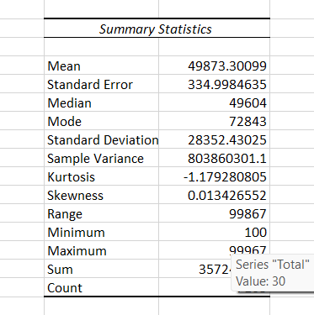
Salary Analysis
I found the the average salary offered by this company.
I used the function AVERAGE() in excel to find the average salary.
I have also found the summary statistics of offered salary.
The average salary of the company is Rs. 49873.3 .

Slide 6
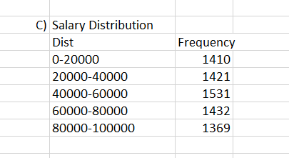
Salary Distribution
The distribution is as follows-
The frequency is evenly distributed that is all the intervals of salary is approximately similar.
The highest number of people lie in the salary range 40000 to 60000.

Slide 7
Departmental Analysis
The graph shows the proportion of people working in different departments.
Operations Department has the highest number of people working in that department followed by the Service Department. HR department has the least proportion of people working there.

Slide 8
Insights and Results
Majority of males get hired compared to females which we visualised in the bar chart also.
The average salary of the company is Rs.49873 approx.
The highest number of people lie in the salary range 40000 to 60000.
Operations Department has the highest number of people working in that department and Hr department has the least number of people working in that segment.

Slide 9
Thank You

